Slide 1
IPL Auction Player Analysis
Insights for Team Management
From-PRATEEK DEO
DATE 19.11.23

Slide 2
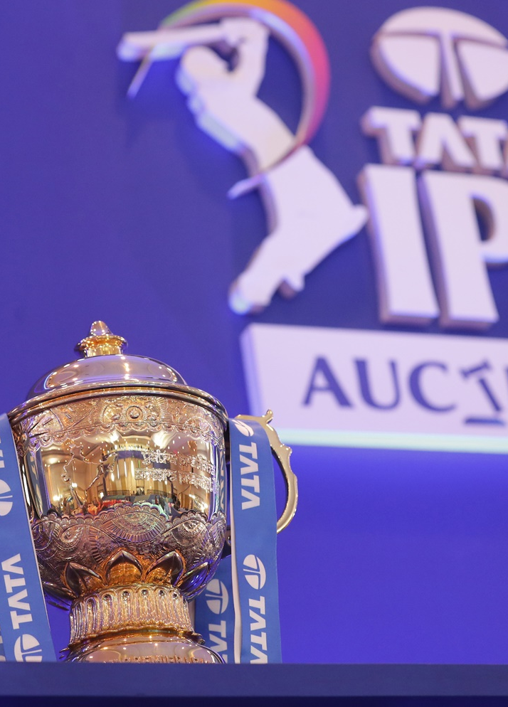
Purpose: The presentation aims to leverage insights to assist in the strategic selection of players for the upcoming IPL auction.
Objective: Identifying key players based on specific criteria, maximizing the team's chances of success.

Slide 3
QUE 1-get 2-3 players with high S.R who have faced at least 500 balls.And to do that you have to make a list of 10 players you want to bid in the auction.
ANSWER -SELECT batsman,sum(batsman_runs) as total_runs,count(*) ball_faced,
(sum(batsman_runs)/count(*))*100 as strk_rate from ball
where extras_type <> 'wides'
group by batsman
having count(*) >= 500
order by strk_rate desc limit 10

Slide 4
QUE2- get 2-3 players with good Average who have played more the 2 ipl seasons.And to do that you have to make a list of 10 players
ANSWER -select batsman, count(distinct year)as no_of_seasons ,
avg(batsman_runs) as avg_runs,sum(batsman_runs) as total_runs
from deliveries_v02 group by batsman
having count(distinct year) > 2
order by no_of_seasons desc limit 10

Slide 5
QUE 3- get 2-3 Hard-hitting players who have scored most runs in boundaries and have played more the 2 ipl season.
Answer- select batsman,count(ball_result) as boundries ,count(distinct year)as no_of_seasons
from deliveries_v03 where ball_result = 'boundary'
group by batsman
having count(distinct year ) > 2
order by boundries desc limit 10

Slide 6
QUE 4 - get 2-3 bowlers with good economy who have bowled at least 500 balls in IPL so far.
select bowler,count(*) as balls_balled ,sum(total_runs) as runs_given,
sum(total_runs)/count(*) as economy from deliveries_v03
where extras_type <> 'wides'
group by bowler having count(*) >= 500
order by economy desc
limit 10
omy desc limit 10

Slide 7
QUE 5- get 2-3 bowlers with the best wicket taking and who have bowled at least 500 balls in IPL so far.
Answer- select bowler,count(*) as balls_balled ,sum(total_runs) as runs_given,
sum(total_runs)/count(*) as economy,sum(case when is_wicket then 1 else 0 end) AS wickets_taken from deliveries_v03
where extras_type <> 'wides’
group by bowler having count(*) >= 500
order by wickets_taken desc
limit 10

Slide 8
Que 6- you need to get 2-3 All_rounders with the best batting as well as bowling strike rate and who have faced at least 500 balls in IPL so far and have bowled minimum 300 balls.
Answer-wITH BATSMAN AS (SELECT batsman,sum(batsman_runs) as total_runs,count(*) ball_faced,
(sum(batsman_runs)/count(*))*100 as strk_rate from ball
where extras_type <> 'wides'
group by batsman
having count(*) >= 500
-- order by total_runs desc limit 10
),
BOWLER AS (select bowler,count(*) as balls_balled ,sum(total_runs) as runs_given,
sum(total_runs)/count(*) as economy from deliveries_v03
where extras_type <> 'wides'
group by bowler having count(*) >= 300
-- order by balls_balled desc
--limit 10
)
SELECT * FROM BATSMAN B, BOWLER BOWL
WHERE B.batsman = BOWL.BOWLER
)

Slide 9
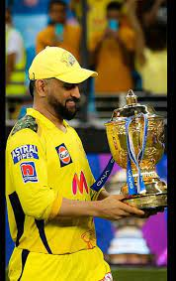
FOR wicketkeeper AND CAPTain of the team ms dhoni AS NO STATS REQ FOR ms

